Slide 1
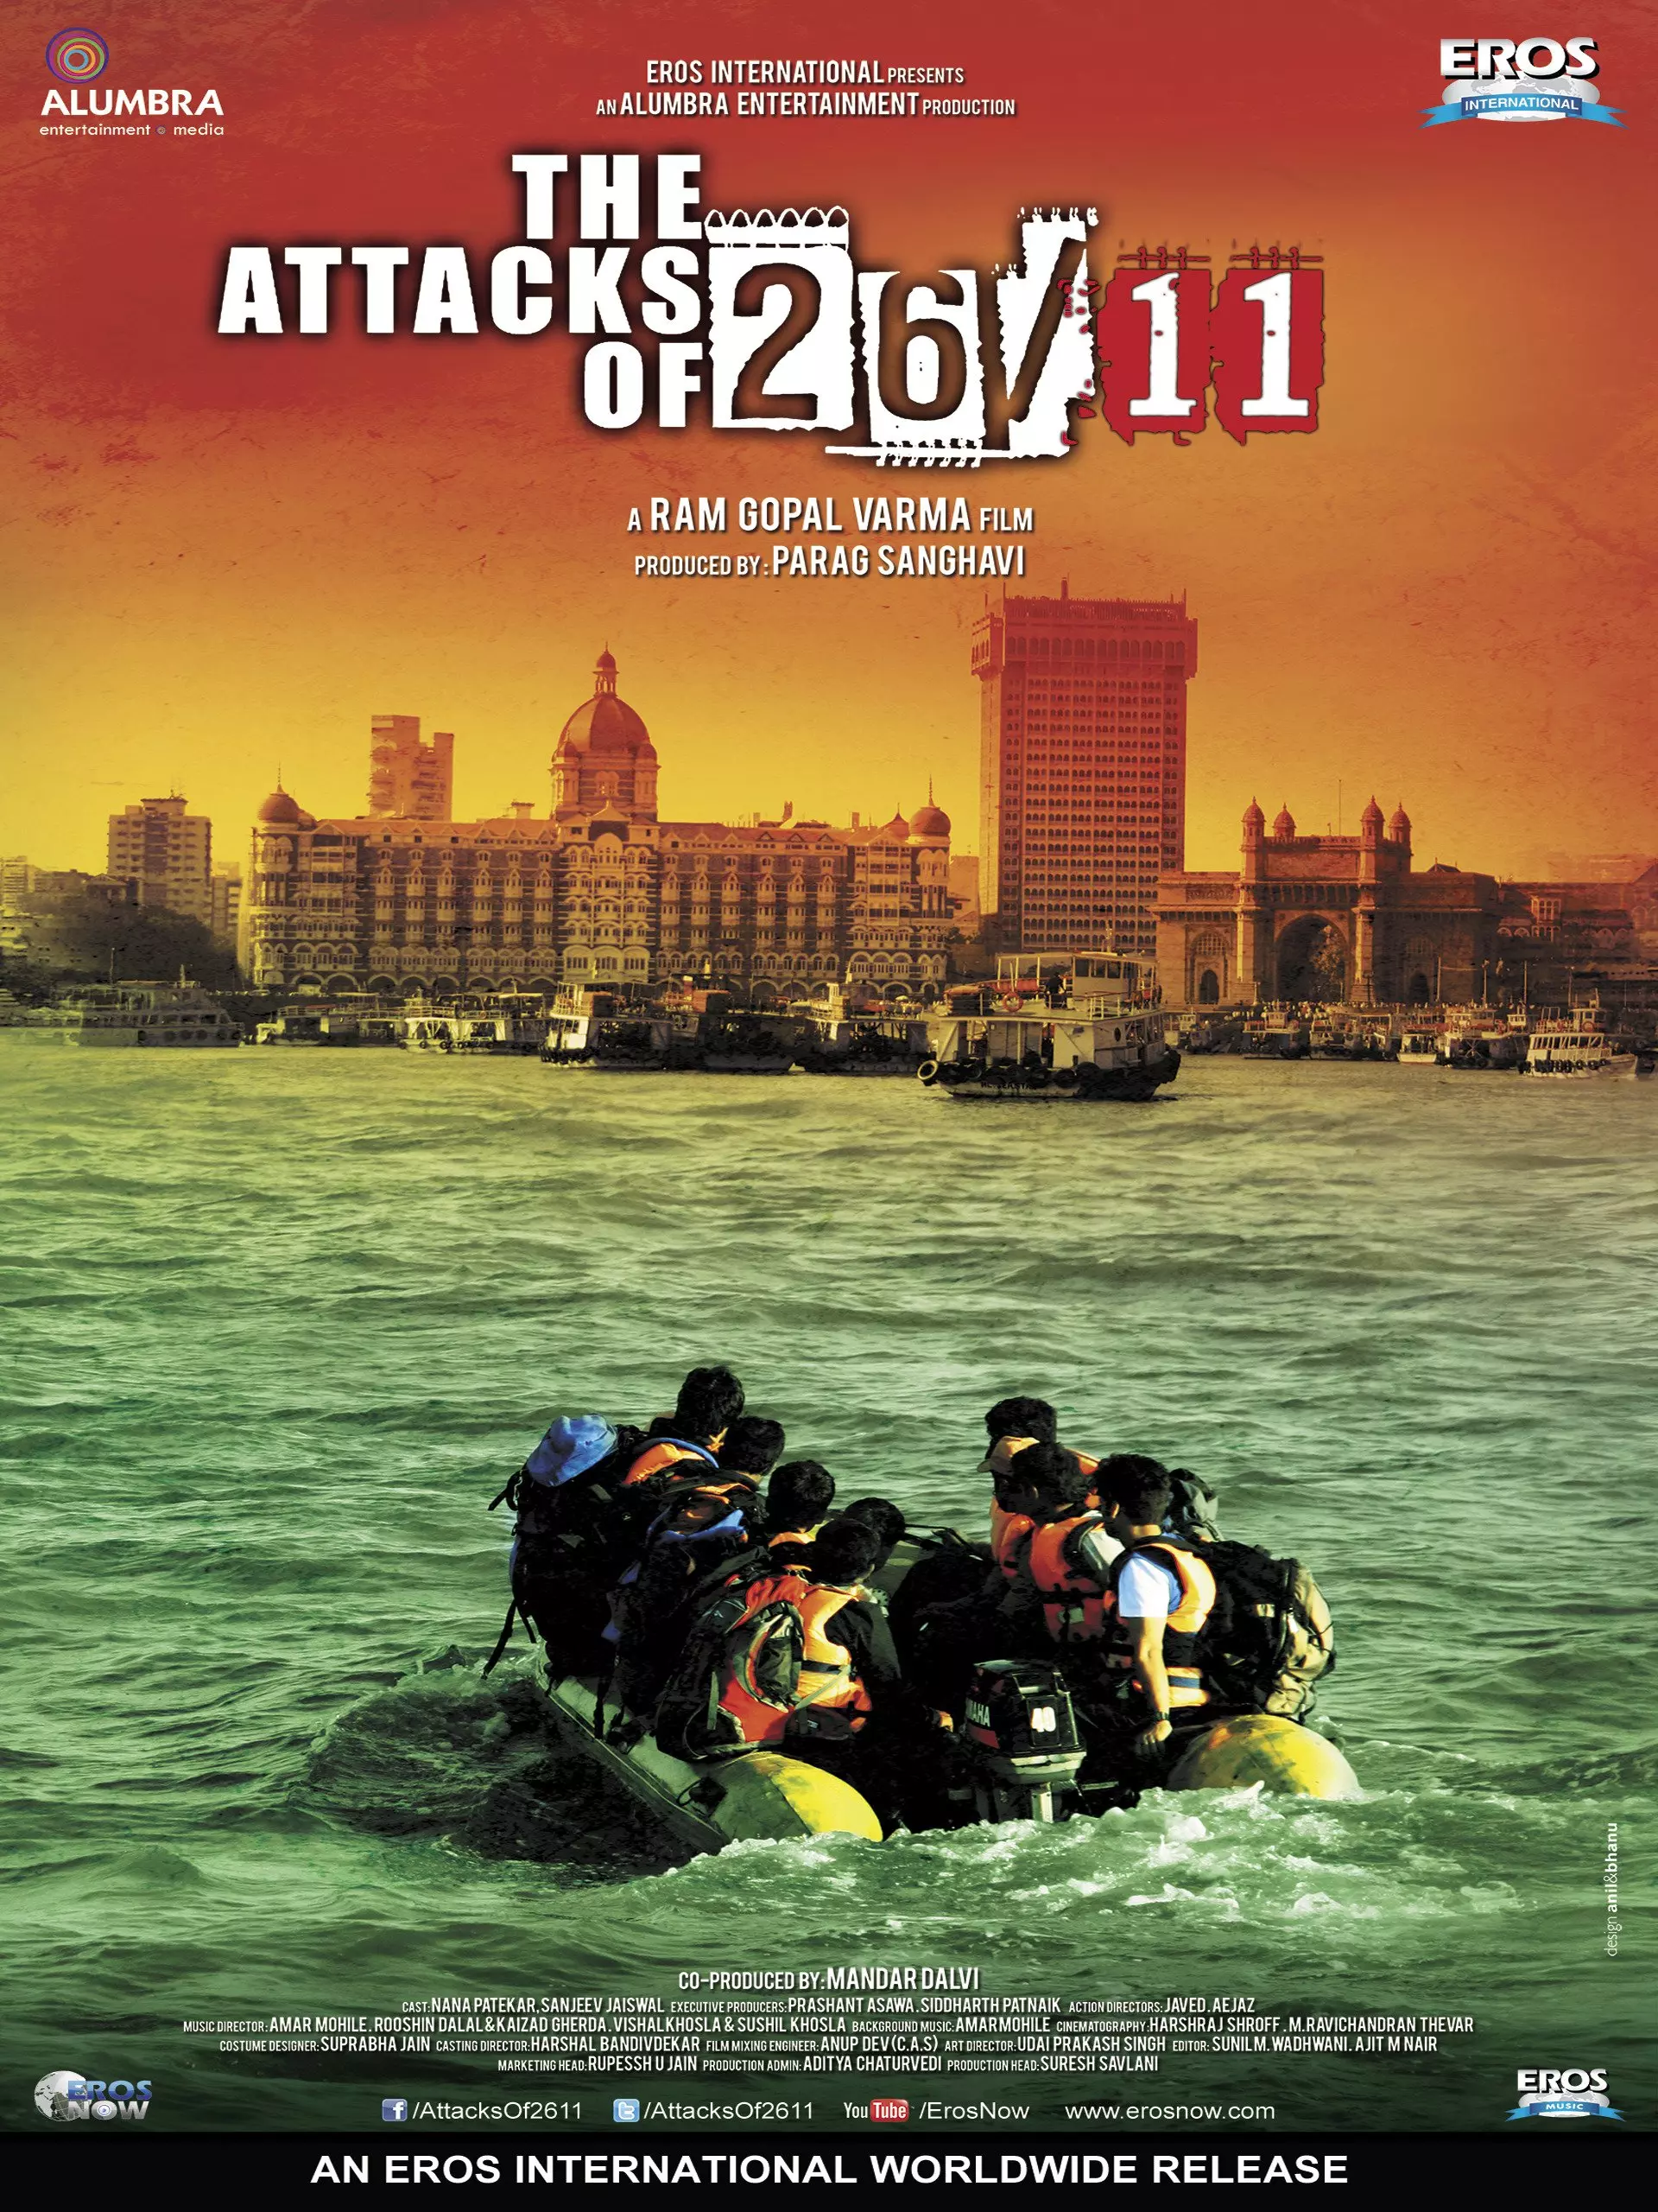
An inspiring story of 10 youngsters of
Lashkar-E-Taiba
who went on an adventurous voyage across MUMBAI.

Slide 2
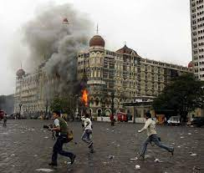
26/11 2008
The image of the front dome of Taj Mahal Palace hotel encapsulated with a large plume of smoke is one that is etched into the memory of every Mumbaikar.🔫🔫🔫🔫🔫

Slide 3
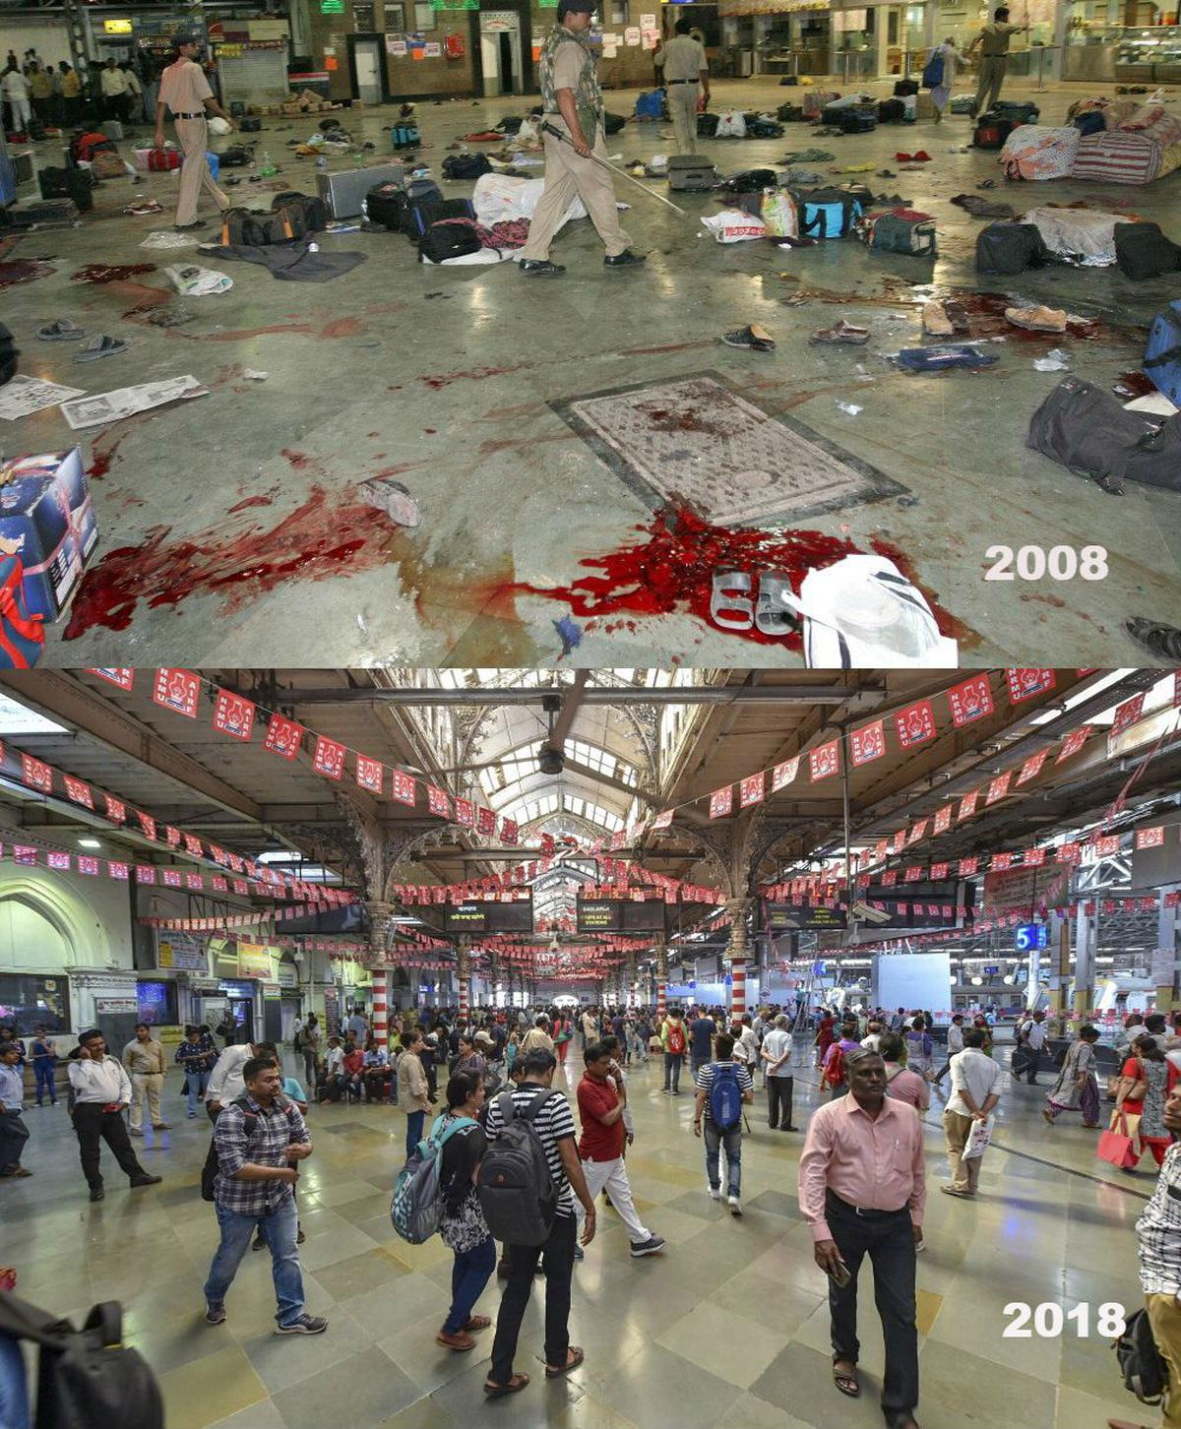
The Lashkar-e-Taiba terrorists targeted five prominent places of the financial capital – Chhatrapati Shivaji Terminus railway station, Nariman House business and residential complex, Cama Hospital, Leopold Cafe, the Oberoi-Trident Hotel, and Taj Hotel and Tower.

Slide 4
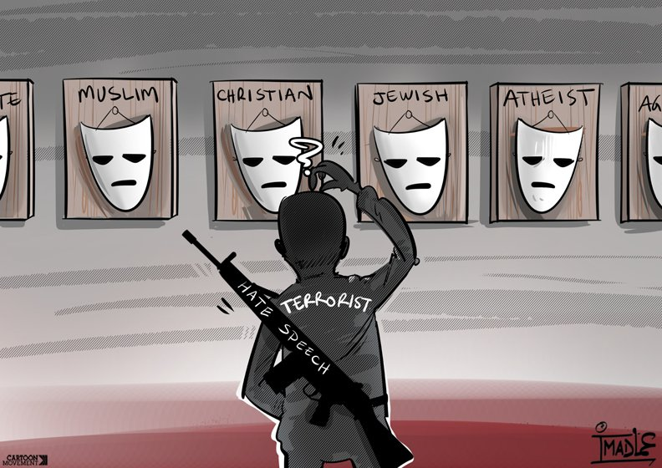

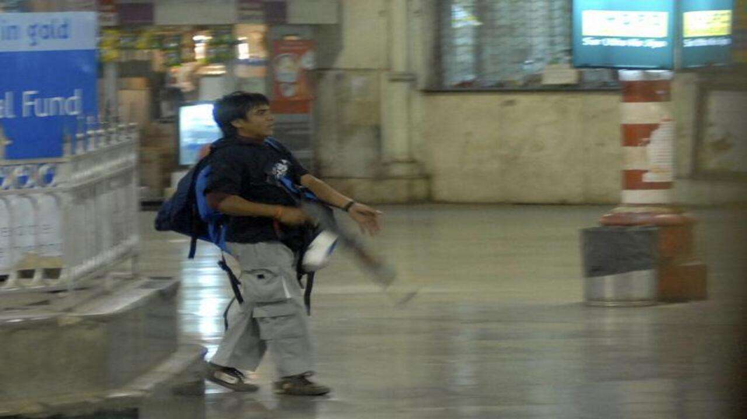
Mohammed Ajmal Amir Kasab
Kasab, alongside fellow Lashkar-e-Taiba recruit Ismail Khan, killed 72 people during the attacks, most of them at the Chhatrapati Shivaji Terminus.[6] Kasab was the only attacker captured alive by police.

Slide 5


